Slide 1











BY
Pasindu Mahima
Search . . .
NGATOR
LEARNING
SAD PRESENTATIONS
learn.ngator.com

Slide 2




BY
Pasindu Mahima
Search . . .
IMPORTANT POINTS TO REMEMBER
ACTION LISTENERS
JFRAME OPERATIONS
SOFTWARE FINALIZING
JASPER REPORTING
java.awt.event.*
javax.swing.event.*
java.beans.PropertyChangeEvent
GUI
Components
Creating a report
Sub Reporting
EXIT_ON_CLOSE
DO_NOTHING
DISPOSE
Logger
Unit Testing
jar, exe and setup files

Slide 3
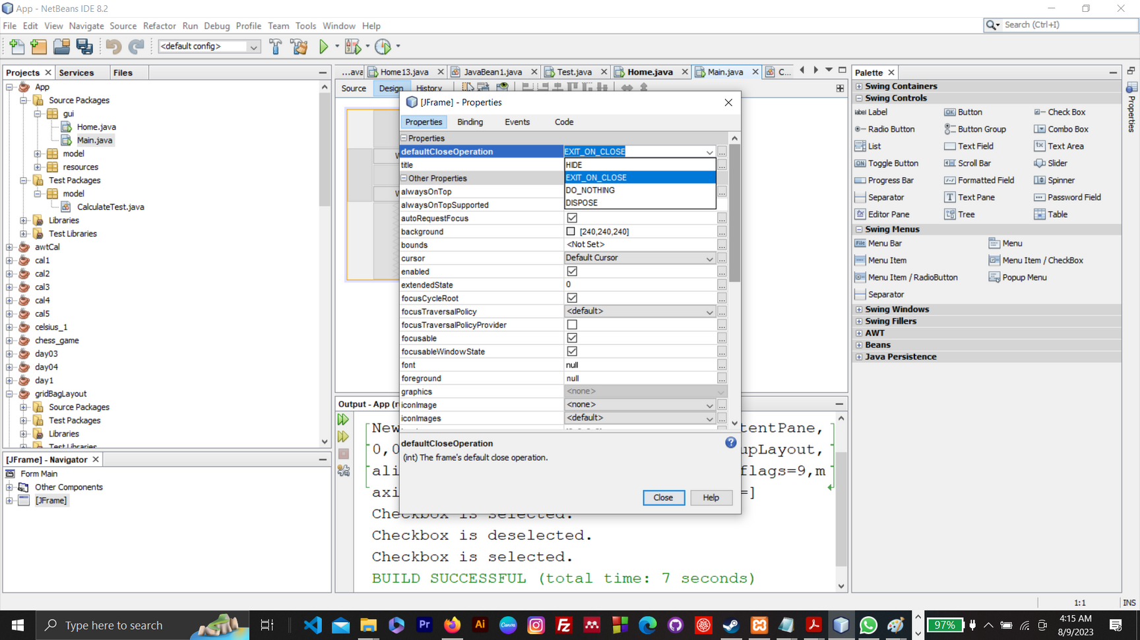
BY
Pasindu Mahima
Search . . .
JFRAME OPERATIONS
EXIT_ON_CLOSE
HIDE / HIDE_ON_CLOSE (Default)
DO_NOTHING
DISPOSE
Methods -
System.exit(0); - EXIT_ON_CLOSE
JFrame.setVisible(false); - HIDE_ON_CLOSE

Slide 4
BY
Pasindu Mahima
Search . . .
JFRAME OPERATIONS
EXIT_ON_CLOSE
HIDE / HIDE_ON_CLOSE (Default)
DO_NOTHING
DISPOSE
Calling the Close Operation
frame.setDefaultCloseOperation(JFrame.EXIT_ON_CLOSE);

Slide 5
BY
Pasindu Mahima
Search . . .
EXIT_ON_CLOSE
When this operation is set and the user attempts to close the JFrame, the application will exit. This effectively calls System.exit(0) and terminates the JVM.
This is not the actual default behavior for a JFrame; if you want your application to exit when the frame is closed, you need to set it explicitly using setDefaultCloseOperation(JFrame.EXIT_ON_CLOSE).

Slide 6
BY
Pasindu Mahima
Search . . .
HIDE / HIDE_ON_CLOSE (DEFAULT)
This is the default behavior. When this operation is set and the user attempts to close the JFrame, the frame will simply be hidden (its setVisible state is set to false), but the application continues to run.
This is useful if you want to hide the main window but perhaps show it again later without having to recreate it.

Slide 7
BY
Pasindu Mahima
Search . . .
DO_NOTHING_ON_CLOSE
When this operation is set, the closing event will not result in any automatic action. Instead, you would typically provide a WindowListener to handle the windowClosing event if you want to perform some action.
This is useful when you want to show a confirmation dialog ("Are you sure you want to exit?") or if you need to perform some cleanup operations before the window can be closed.

Slide 8
BY
Pasindu Mahima
Search . . .
DISPOSE
When this operation is set and the user attempts to close the JFrame, the window is disposed of, meaning all its resources are released, but the application might continue to run if there are other threads or windows active.
If this is the last window being closed and no other non-daemon threads are running, the application will exit.
This is especially useful in applications with multiple frames, where closing one frame shouldn't terminate the entire application, but you want to release the resources associated with that frame.

Slide 9
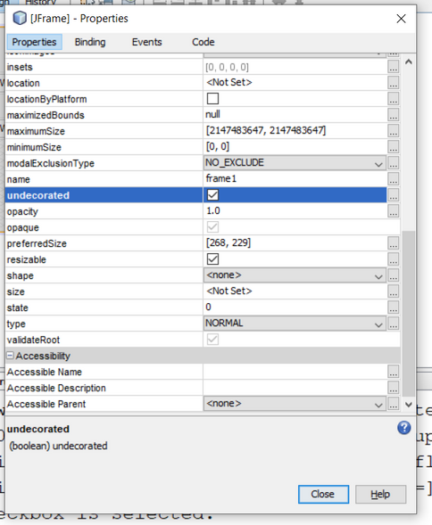
BY
Pasindu Mahima
Search . . .
REMOVING THE MENU BAR OF JFRAME
Properties > Tick the Undercorated property
When you do this, you can't move the JFrame.

Slide 10
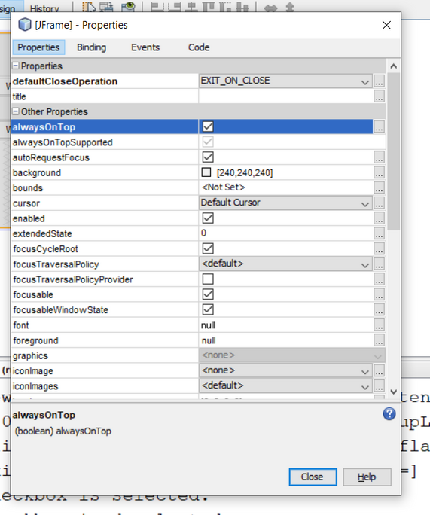
BY
Pasindu Mahima
Search . . .
ALWAYS ON TOP
Properties > Tick the alwaysOnTop property

Slide 11

BY
Pasindu Mahima
Search . . .
THANK YOU
Social Profiles
Follow Ngator on social networks
Facebook : https://www.facebook.com/learnwithngator
Instagram :https://www.instagram.com/mahimapasindu/
GitHub : https://github.com/drgnhunter
LinkedIn : https://www.linkedin.com/in/pasindu-mahima-3a0031187/
END SLIDE

